Slide 1
D-311 Unit 5:
IA Environment & WildCAD-E Intro

Slide 2
Objectives
Students will be able to :
Identify three unique elements that the IADP should receive from a briefing.
Identify and discuss common situations that create stress in a busy dispatch environment.
Describe four techniques that are effective in responding to urgent/stressful situations.
Utilize WildCAD-E to map, send texts, create and maintain incident(s).

Slide 3
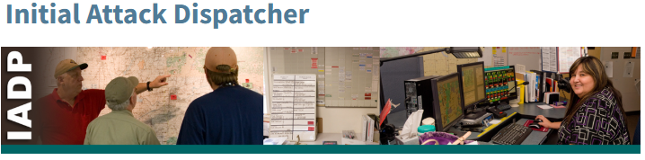
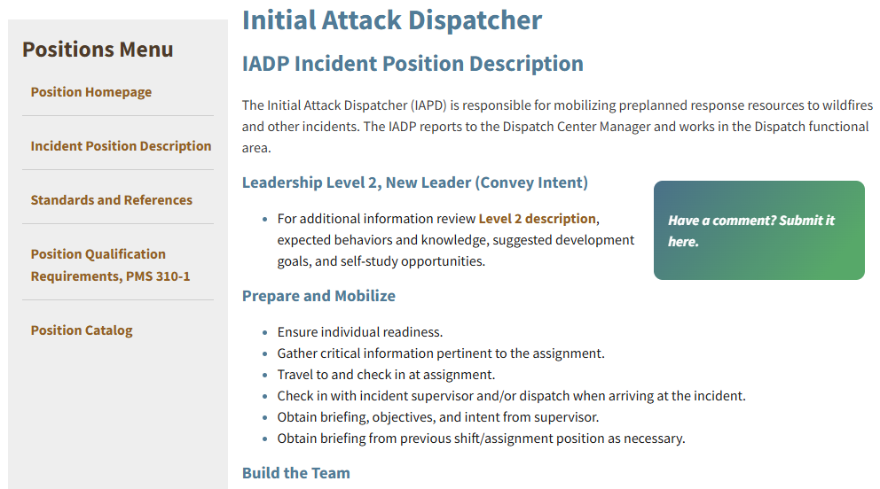
Incident Position Standards Alignment
https://www.nwcg.gov/positions/initial-attack-dispatcher

Slide 4
Dispatch Environment
  Dispatcher Briefing
  Three key elements needed to be successful in a dispatch environment.
  1) Local protocols
  2) Delegated authorities
  3) Management expectations

Slide 5
Dispatch Environment
    Local Protocols
    May be outlined in formal and informal ways e.g. manuals, guides, or checklists.
    Local protocols are standard business practices in that area.
    Delegated Authorities
    This defines the limits and boundaries for your actions. These may be written, given orally, or implied.

Slide 6
Dispatch Environment
    Management Expectations
      This defines the range of your work activities and will give you an idea of how independently or supervised you will function.
      The initial briefing, mentoring, discussions, and shift briefs are all sources of information.
      These are effective ways to begin to learn unique local conditions, staffing policies, available resources, chain of command, and the agency/local management expectations.
      In most situations it will take you several operational periods to develop proficiency. Remember – it does not happen all at once.

Slide 7
Stress in the Dispatch Environment
  Common Situations that Cause Stress
    A factor in a successful performance as an IADP is the ability to work productively in an environment where stress is common.
    Recognizing stressful situations and knowing how you respond to stress, are key to managing yourself in this demanding environment.
    Stress can be divided into three categories:
      Internal stress
      External Stress
      Organizational Stress

Slide 8
Stress in the Dispatch Environment
      External Stress (environment)
      Events outside your personal control such as:
      Being crowded
      Supervisor
      Weather conditions
      Noisy
      Media on the phone
      Room temperature

Slide 9
Stress in the Dispatch Environment
      Internal Stress
      Yourself
Exhaustion/poor sleep habits
Co-Worker interaction
Personal situations
Poor eating habits’
Others?

Slide 10
Stress in the Dispatch Environment
      Organizational Stress
      Conflicts that are inherent to a dispatch system.
      What are some organizational stressors?

Slide 11
Stress in the Dispatch Environment
  Responding Effectively to Stressful Situations
    Stress challenges us. It requires adaptation or adjustment. Some techniques that are effective in adapting/adjusting to stress in the initial attack environment are:
      Focusing on the job
      Recognizing escalating situations
      Notifying your supervisor
      Prioritizing tasks
      Delegating tasks
      Rotating jobs
      Taking breaks
      Requesting/ordering additional help
      Being organized
      Accepting personal limits

Slide 12
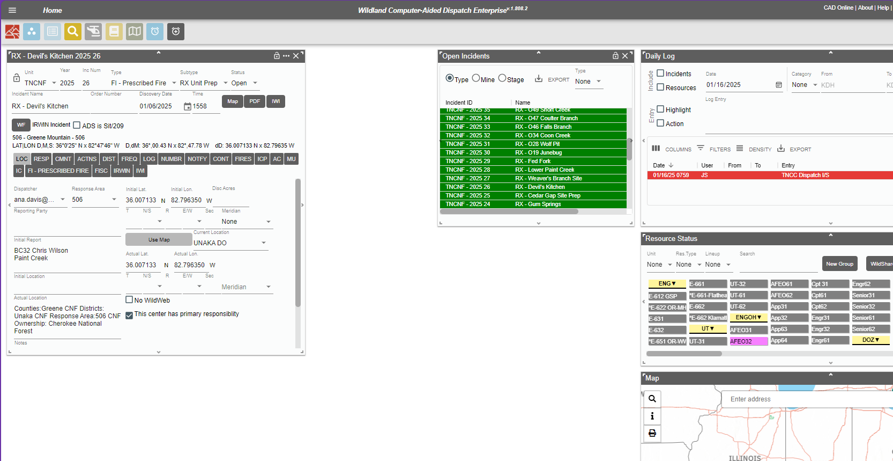
Intro to WildCAD-E
This section will give you an overview of the WildCAD-E Dispatch program.
You will complete exercises within the system for mapping, creating and maintaining incidents.

Slide 13

WildCAD-E Menu Icons
1
2
3
4
5
6
7
8
9
1)Create New Incident Icon (F9)
2)Create a New Complex – Will bring up prompt window to confirm
3)Open the Open Incidents Panel (F8)
4)Open Search Incidents Panel (F2)
5)Open Resources Status Panel (F7)
6)Open the Daily Log Panel (F12)
7)Open the Map Panel (F5)
8)Open the Timers Panel (F4)
9)Create New Timer

Slide 14
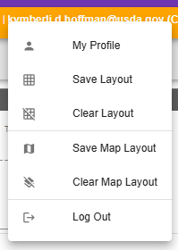
WildCAD-E Menu Icons

Slide 15
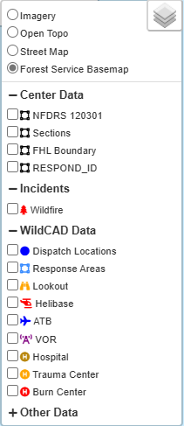
WildCAD-E Map Menu

Slide 16
Mapping Exercises
Please see Handout –
D-311 Unit 5 WildCAD-E Exercises Handout 1 - Incident Mapping

Slide 17
Incident Panel Exercises
Please see Handout –
D-311 Unit 5 WildCAD-E Exercises Handout 2 - Incident Panel Tabs

Slide 18
Incident Panel Exercises
Exercise 2.1
Filling out the Incident Panel Header
  Open the first name-C incident you created in last exercise. (Open incident Panel F8)
  Select Unit Id as CALPF for the Los Padres NF.
  Type (Incident) – Leave as Smoke Chk. (should be default for most centers)
  Subtype leave as None.
  Status you will leave as Open.
  Incident Name – Should reflect student first name and - C.
  Order Number is to reflect the Incident Order number as reflected in IROC. Leave blank until it is a confirmed WF. Format would be CA-LPF-XXXXXX. This also reflects on the incident pdf.
  Discovery Date and time is auto generated when the incident it opened.
  Lock icon on the left side of the header will lock the incident header information, so it cannot be accidentally changed.
  Map button will map the location entered in the incident.
  PDF button will pdf the incident log, you can download to a location on your computer.
  IWI will start a new IWI incident connected to the parent. It will default the default incident type for the center.

Slide 19
Incident Panel Exercises
Exercise 2.2
LOC Tab
  Will have Dispatcher name, Response Area field is based on where the location of the incident plotted.
    The Initial Lat/long and/or TRS fields should be filled in based on the when you initially plotted the incident during that exercise.
  Disc Acres – Should be left blank until it is a confirmed wildfire. This is a field that will integrate data to IRWIN when filled in. You will want to wait and have a discussion with the Floor Coordinator before doing anything with codes.
  Reporting Party is the name and number of who reported the incident information.
    For the exercise Enter Smokey Bear 800-123-4567.
  Initial Report is the information given by the reporting party.
    For this exercise type the following information – large smoke column to the North of Nira Campground off Sunset Valley Road.
  Initial Location field is a free-type field that each center will have standards for. For this exercise type the county that shows up for the location at the bottom of the map in the grey footer section. You can also copy text from the footer section. For this Exercise Type Los Padres NF. You can determine this by Unit ID and Zooming out on the map.
  Actual Location field will be left blank until Point of Origin (P.O.O.) is confirmed.
  Notes field is center specific.
    Nothing to enter for this exercise.
  Web Comment is a center specific field.
    Nothing to enter for this exercise.
  This Center has primary responsibility check box means this center has the data authority for this incident.
  No Wildweb checkbox is used when you do not want and incident to show on wildweb. This field is center specific. Leave unchecked for this exercise.
  What do you notice about the fire location that would be important to let your floor supervisor and Duty Officer know? - near or in a Wilderness Area

Slide 20
Incident Panel Exercises
Exercise 2.3
RESP Tab
  This tab is where resources will be assigned to the incident along with their responding status. Instructor needs to go over run cards and explain how the columns work and suggested resources.
  In the Resource Panel set the Lineup dropdown to SBD.
  Assign the following resources by clicking on it in the Resource Panel and then click Assign button on incident response tab.
  The response for this fire on a moderate day will be:
    2 Engines – E44LPF, E343LPF
    Patrol – PAT42ALPF
    Overhead – BC41LPF
    Water Tender – WT23LPF
    Air Attack – AC Desk Will handle
    Air Tanker – AC Desk Will handle
    Helicopter – HEL528LPF
    Dozer – DOZ41LPF

Slide 21
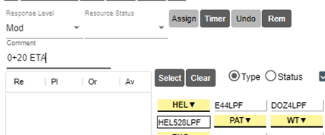
Incident Panel Exercises
Exercise 2.3
RESP Tab - Cont
  Once all resources are committed, then you will select them all by clicking Select button and changing the Resource Status drop down to Responding.
  You can click the Select button to status all resources at once or individually.
  Comments typed in the Comment line will be auto logged in the incident LOG tab.

Slide 22
Incident Panel Exercises
Exercise 2.4
LOG Tab
  All incident documentation is entered into the Log tab. Phone calls, radio traffic, and inter-office communications.
  From – who the communication is from
  To – Who the communication is too
  Log entry field – A summary of the communication goes here. It is a good idea to capture both sides of the conversation when applicable, so if there is ever a question it can be clarified.
  Enter Initial caller’s smoke report information and phone number into incident log tab.
  Phone call from Duty Officer Ken Smith “I am working on getting approval for use of Chainsaws and Helicopters in the wilderness if needed”
  Radio Traffic E-343 calls into to notify you they are on scene. (IG and Key – Prompt to go back to resp tab and status on scene.
Exercise 2.5
FREQ Tab
  This tab is where you assign and maintain assigned frequencies for this incident.
  Each center will have SOP’s on who and how frequencies get assigned.
  Click the Frequency Type drop down in the lower 1/3 of the tab.
    Select Air to Ground and check box for LPF A/G 41 – 167.4750 (Primary) and click Add button.
    The frequency selected then shows in the top box as an assigned frequency.
  Return to drop down and assign/add Command FN, LPF 164.9125T – Chews Ridge.

Slide 23
Incident Panel Exercises
Exercise 2.6
IC Tab
  Click the IC tab and click the plus sign to add the current IC.
  This will add a new line, click the box at the left. Click in the name column.
  Enter the IC Name – ICT4 Woodsy Owl and click the Effective date column, enter current date and time. Formatted 1/28/25 @ 1645.
  Click the save button (disk Icon) to set the IC.
  ICT4 Trainee is Rick Black same effective date and time.
  Some Centers want the IC type entered as well, so follow the SOP’s.
  This field should be updated every time the IC changes.

Slide 24
Incident Panel Exercises
Exercise 2.7
FIRES Tab
  You are given a snapshot size up when E343 arrives on scene.
    “Burning in Timber and Grass, on FS Jurisdiction, looks to be about 5 acres, with winds NE at 5mph, fire is on a 20% slope SE aspect showing moderate rate of spread. Have a Type 4 IC Woodsy Owl. No known hazards or structures threatened, access is the Potrero Canyon Road to the intersection with Hurricane Deck Road.”
    Fill in the appropriate fields in the Fires tab.
    Is there anywhere else this information should be documented?
  Class discussion covering the remaining fields: Add more to IG
    Fire Growth
    Initial and Fire Report radial buttons
    Fire # and use of auto function
    Subunit and use of auto function
    Acres and Cls (auto populated)
    Land Stat
    Elevation
    Wilderness check box (shows on reports)
    Contained, Controlled and Out Dates and Times
    Fire Cause (LPF has no data – do we need to add to every course)

Slide 25
Incident Panel Exercises
Exercise 2.8
FISC tab
  You will want to wait and have a discussion with the Floor Coordinator before doing anything with codes.
  Click the FISC tab. This is where fiscal codes are pulled or managed for the incident depending on the code needed.
  You can pull a fiscal code for any FI or False Alarm incident type using the get fire code button. Certain fields must be completed within the incident to pull a code through IRWIN.
    Incident named, mapped, correct incident type selected, Date & time is auto generated, discovery acres.
  All other codes can be typed in the Other Fiscal Codes field.
  ABCD Misc. Codes and be typed in their field or other field.
  Remember to put in the FS Job Code and override.
  If there is a reason to enter Unprotected Response Reason, use the drop down.
  Check boxes must be checked before submitting for a code. Some centers have it defaulted to always check FS Assist.
  Always follow center SOP’s and check with Floor lead before pulling codes.
  Type P5EK5S-0507 (ABCD Misc. code) in the appropriate fields.

Slide 26

Incident Panel Exercises
Exercise 2.9
RESOURCE TIMERS
  To start a timer, click the gray open timer icon in the top of WildCAD-E.
  Click the Resource drop-down and assign resource.
  Assign incident if needed, by using the Assigned Incident drop down.
  The timer will automatically start counting down based on Interval time. You can change incident time by adjusting that field. It will also adjust the Time From and Alert Time.
  Click the checkbox next to Sound if you want sound with the alert, which the timer box will flash red.
  Type in the field under the Status OK button and click Status OK to rest timer interval to enter information into the timer log below .
  Fore additional information that will not reset timer interval, type in the field under the Other button and then click the Other button to add to timer log below.
  For aviation: information is usually copied from AFF and pasted into the Status OK field.
  You can fill out he individual fields of Lat, Long, Heading, etc. but it will not show in the timer log, recommended not to use. Fields should be going away in a future version.
  Instructor review the MUTE, CLOSE, SNOOZE buttons in timer. Show how to scroll in the timer log to see all entries. Review the Open Timers panel and how to re-open a timer.
  Instructor have students open timers, assign resources, log, snooze, close and reopen timers.
  Instructor have the students go to Menu>Reports>Resources>Timer report, search and open timer and pdf timer.

Slide 27
Incident Creation Exercise
Exercise 3.1
SMOKE REPORT
Caller Tilda Canterberry 658-333-2354 is on CA Hwy 33 at Pine Mountain Summit and sees a smoke column about 1 mile to the east. (Answer Place name PINE MTN RD/HWY 33). Follow previous naming convention for Incident.
You call Duty Officer Smith to notify him of the report and he wants you to dispatch E355 LPF and E352 LPF and see what they find.
Approximately 30 mins later E355 calls on the radio and let you know they have arrived on scene and states that they have a 1-acre fire on FS Jurisdiction, with low rate of spread. They will get back to you with a full size up in 5 minutes.

Slide 28
Incident Creation Exercise
Exercise 3.1
SIZE UP
E355 calls on the radio on Repeater Sisar Peak with a full size-up “Fire Name Reyes Peak, Lat/Long is 34.6494 x 119.3675 on Reyes Peak Road about 3 miles in from Hwy 33 at Pine Mountain Summit. 1 Acre, burning in grass and brush, Character of fire is creeping/smoldering, Low rate of spread, 5400’ elevation, on a flat aspect and right next to the road. 0-10% slope, winds are 5mph from the west, there are no control issues, no property threatened, and hazards are public travelling the FS Road. Only additional resource needed E352 that is already en-route but has not arrived on scene, and a fire investigator. ICT5 will be Becky Campbell and ICT5 trainee is David Stuart. Believe the fire to be human caused due to proximity to the roadway. Nothing further at this time.”
5 mins later E352 calls on the radio to notify they have arrived on-scene and are tying in with the IC.

Slide 29
Incident Creation Exercise
Exercise 3.1
FOLLOW UP
Duty Officer Smith Calls to get an update on the fire.
2 Hours later the IC calls in to notify you that the fire was contained and will be in patrol status and all resources are departing the fire for station.
Pdf incident – and email to coach they can review and go back over any errors.

Slide 30
Activity slide
WildCAD-E Texting
Go to incident Student Name – C
Go to LOG tab
Select Text/Email button
Select Instructor Group under Group name Drop Down
Click boxes and Add to Recipient List to move names to the right
Go to Compose Preset Message section
Select CONFIRMED FIRE preset message
Enter appropriate information (hint size-up?)
Send Text button
Instructors will review texts for correctness

Slide 31
Activity slide
WildCAD-E Texting
Go to Home Screen, click 3 lines upper left
Select Text/Email
Select Instructor Group under Group name Drop Down
Click boxes and Add to Recipient List to move names to the right
Subject Line: WX Alert
Message Line type – High Wind Alert for Front Range
Send Text button
Instructors will review texts for correctness

Slide 32
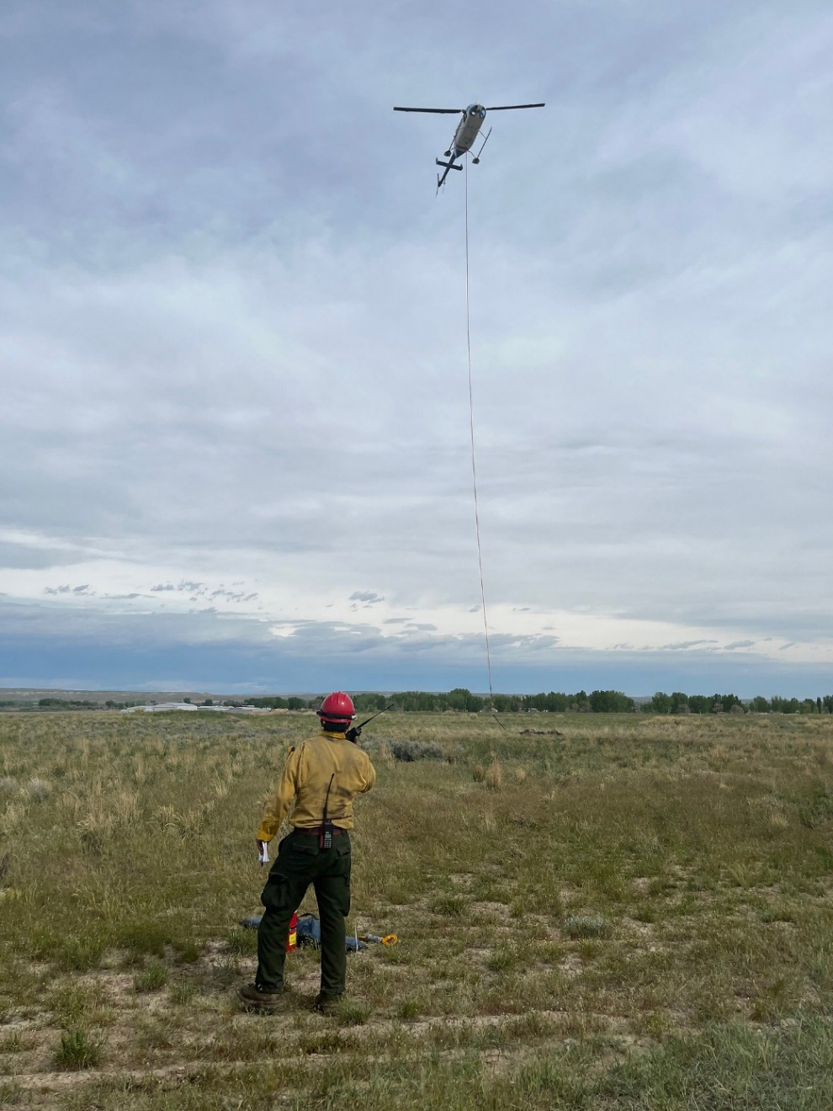
Activity slide
E343 calls in and calls fire
Contained @ 1523
E343 calls in and calls fire
Controlled @ 1752
E343 calls in and calls fire
Out @ 1935
Where should this be
Documented?
*Use current date*

Slide 33
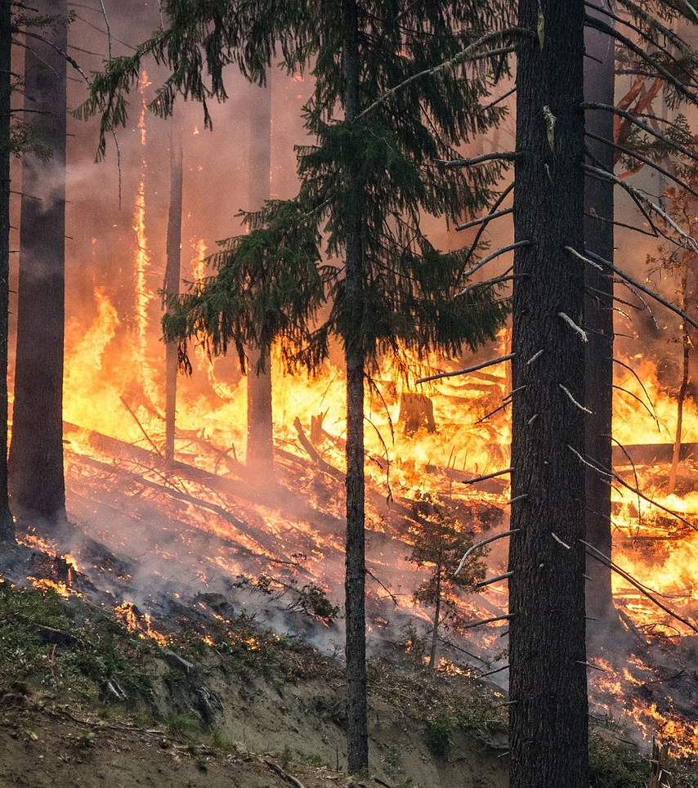
Knowledge Check
Question? Where you enter fire size up information?
Answer: Fires tab and Log tab

Slide 34
Summary
This unit focused on how the IADP should prepare for working in the dispatch environment, how to manage stress and overview of the WildCAD-E computer application.
Objectives
Identify three unique elements that the IADP should receive from a briefing.
Identify and discuss common situations that create stress in a busy dispatch environment.
Describe four techniques that are effective in responding to urgent/stressful situations.
Utilize WildCAD-E to map, send texts, create and maintain incident(s).
Notes:
Guides and Key
The presentations and instructor guides include notes to aid facilitators in instruction.
Key
Indicates an action for the instructor to take.
Indicates topics and information for the facilitator to use as they see fit.
Example Notes
Review unit objectives.
Exercise
Advise participants that the next few slides will introduce common terms that describe parts of a fire.
Pre-Video Discussion
In this scenario, firefighters have arrived on scene of a new fire. They are gathering and communicating their situational awareness of the current fire behavior.
Play Video
Title Basic Fire Terminology
Summary State the summary
Time (02:20)
Audio
Post-Video Discussion
This unit will discuss many of these terms in more detail.
Question: Identify this fire behavior.
Answer: Torching
Note to Instructor
The fuel types listed on this slide will be discussed in detail in Unit 2.
List Level 1
List Level2
Example
Example
List Level 1
List Level 1

